Slide 1
Web Page Protocols
How Do We Get a Web Page?

Slide 2
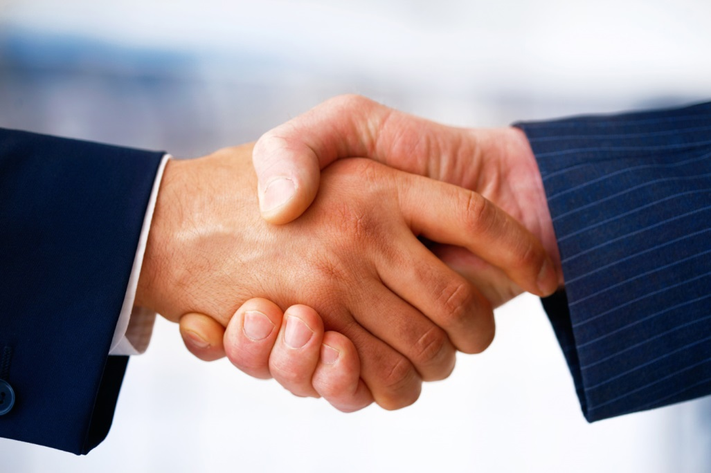
Web Uses Protocols
Protocols say what to do, when
Human protocols: handshake
Protocols allow computers to communicate
Made by people, for people
Protocols can climb
the ladder of
abstraction
Notes:
Protocols can sit one on top of another. After a handshake, there are more protocols that let a conversation build to a more and more meaningful exchange.

Slide 3

Web Uses Client Server Architecture
Clients
Many clients can initiate two-way communication
Common clients: Firefox, Chrome, etc.
Server
Server holds data/web content
Common web server program: Apache
Notes:
All Internet communication is end-to-end: two computers, having a two-way conversation. For the web, one of the computers is the client, and the other is the server. Remember that the two way arrows shown in this diagram actually involve other computers along the way, who pass the messages along from one end of the connection to the other. You're familiar with the client end, the applications like Safari, Internet Explorer, Firefox, and Chrome. You type in a URL that contains a domain name, and your client application gets the IP address for the server using the DNS. Then your client opens a connection to the server. The client sends packets addressed to the server, and the server sends packets addressed back the client. A server program is usually called a daemon and runs on the server computer. For a website to stay up, the daemon program has to always be running on a server computer with uninterupted access to the Internet.

Slide 4
Web Uses Protocols
IP Header
TCP Header
HTTP Header
HTML Header
HTML Body
HTTP Body
TCP Body
IP Body
Notes:
Computers communicate using protocols. Protocols are just mutually agreed upon standards. Committees, companies, any group of people can agree upon a protocol.
This picture shows the protocols we will address in this lesson. They move up the ladder of abstraction as you move inward on the diagram. IP and TCP work together to carry a wide variety of payloads, including HTTP.
IP addresses the packets. TCP numbers the packets. HTTP says “I want this web page.” The details are not so important – unless you’re the one who worries about that level of abstraction.

Slide 5
Some Acronyms
Protocols
TCP = Transmission Control Protocol
IP = Internet Protocol
HTTP = Hypertext Transfer Protocol
Languages
HTML = Hypertext Markup Language
CSS = Cascading Style Sheet
Notes:
Recite the acronyms and their full names out loud. Doing so creates new neural connections in your brain devoted to saying and thinking these phrases.

Slide 6
Web Content Is HMTL, CSS, JavaScript…
HTML: Marks up meaning of content
CSS: Stylizes the content
JavaScript: Makes the content interactive
<HTML>
<HEAD>
<TITLE>Great web page</TITLE>
</HEAD>
<BODY>
Some great content
</BODY>
</HTML>
Notes:
Ultimately the goal is to exchange information between client and server. A web server sends content in the form of text (represented in binary as UTF-8, typically). The text has to be embedded inside HTML tags, shown here, for describing the content. On most web pages, the HTML also includes islands of CSS to tell the browser how to render the content and JavaScript for making the content interactive.
But the web content has to get from one machine to another. Any two computers on the Internet can exchange packets with each other. The protocols that let them do that can carry web data or any other data.

Slide 7
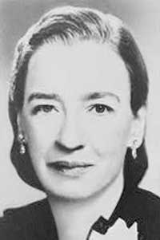
Web Uses Protocols to Send Content
IP Header
TCP Header
HTTP Header
HTTP Body
TCP Body
IP Body
Notes:
The body of the HTTP packet could have also been image data.
Note: Image is Grace Hopper, creator of COBOL, as cited in Activity 1.2.1.

Slide 8
TCP/IP Carries All Internet Content*
IP Header
*Almost
TCP Header
TCP Body
IP Body
Notes:
And the TCP/IP packet could have contained some other payload instead of HTTP.
Note: 2% of Internet traffic uses UDP instead of TCP. The User Datagram Protocol does not verify delivery nor check for errors, so it is only used for delay-sensitive services like human conversation.

Slide 9
IP Is for Addressing and Routing
IP Header
Addressing
IP Body
Notes:
So what do all these protocols look like?
IP takes care of the addresses. The client says “I’m 4.5.6.7 and I’m talking to 2.9.0.255 .”

Slide 10
TCP Verifies Delivery and Accuracy
IP Header
Addressing
Sequencing
TCP Header
TCP Body
IP Body
Notes:
In the TCP header, the client adds, “I want a web page”
The server (who is 2.9.0.255) says “OK, I’m listening.”
The client says, “OK, I’m listening too. That was the TCP handshake – more on that in a bit.

Slide 11
Web Uses Protocols and Languages
IP Header
TCP Header
HTTP Header
HTML Header
HTML Body
HTTP Body
TCP Body
IP Body
Notes:
But the client also puts a payload in the TCP/IP packet. The client follows HTTP protocol and says in the HTTP header “What I want is in the animals directory and it’s called elephant.jpg”
The server says, “I’ve got that web object. Here is the first of 92 parts of it.”

Slide 12
Web Uses Protocols and Languages
IP Header
TCP Header
HTTP Header
HTML Header
HTML Body
HTTP Body
TCP Body
IP Body
Notes:
Then the server sends the page in additional packets, possibly one but possibly hundreds. The packets travel multiple routes through the Internet, getting passed along by computers along the way.
After the latency, the client hears, “Here’s part 2 of it,” “Here’s part 4 of it,” “Here’s part 7 of it,” as they arrive out of order. The client acknowledges what’s been received: “I’m ready for part 3 of it.”
Of course, packet 3 was already sent, so the server will just keep sending in order. “Here’s part 12 of it,” “Here’s part 13 of it,” “Here’s part 14 of it,” and so on.
Several packets down the line, the client has everything up to packet 11, is missing 12, and then has 13, 14, and 15. The client reports, “I’m ready for part 12.” But part 12 never arrives. With each arrival, the client repeats, “I’m ready for part 12.” “I’m ready for part 12.” “Here’s part 19.” “I’m ready for part 12.”
The server finally sends part 12 again. The rest of the exchange proceeds without dropped packets.

Slide 13
Web Uses Protocols and Languages
IP Header
TCP Header
HTTP Header
HTML Header
HTML Body
HTTP Body
TCP Body
IP Body
Notes:
The server finally says, “Here’s part 92 of it. I’m closing our connection.”
If the client wants anything more, it has to start all over again.

Slide 14
Web Uses Protocols and Languages
IP Header
TCP Header
TCP Body
IP Body
Notes:
“I’m 4.5.6.7 and I want a web page from 2.9.0.255 .”

Slide 15
Protocols Climb Ladder of Abstraction
IP Header
TCP Header
HTTP Header
HTML Header
HTML Body
HTTP Body
TCP Body
IP Body
Notes:
Application programmers work up in the high layers of abstraction. Roughly half of current job positions are for application programmers. Like regular computer users in an organization, they depend on network administrators and network architects to understand how the network works. These people – the other half of the computer specialists’ job openings – know the tools to diagnose and solve problems at lower levels of abstraction.
At the low level of abstraction, we know that computers exchange 0s and 1s to communicate. At a high level of abstraction, we don’t have to worry about that. The further into the center of this diagram you go, the higher the level of abstraction.
Note: The full dialogue is here for reference.
Computers communicate using protocols. The client says “I’m 4.5.6.7 and I want a web page from 2.9.0.255 .”
The server (who is 2.9.0.255) says, “OK, I’m listening.”
The client says, “OK, I’m listening too. That was the TCP handshake– more on that in a bit. The client also says, “What I want is in the animals directory and it’s called elephant.jpg”
The server says, “I’ve got that web object. Here is the first of 92 parts of it.” Then the server sends the page in additional packets, possibly one but possibly hundreds. The packets travel multiple routes through the Internet, getting passed along by computers along the way.
After the latency, the client hears, “Here’s part 2 of it,” “Here’s part 4 of it,” “Here’s part 7 of it,” as they arrive out of order. The client acknowledges what’s been received: “I’m ready for part 3 of it.”
Of course, packet 3 was already sent, so the server will just keep sending in order. “Here’s part 12 of it,” “Here’s part 13 of it,” “Here’s part 14 of it,” and so on.
Several packets down the line, the client has everything up to packet 11, is missing 12, and then has 13, 14, and 15. The client reports, “I’m ready for part 12.” But part 12 never arrives. With each arrival, the client repeats, “I’m ready for part 12.” “I’m ready for part 12.” “Here’s part 19.” “I’m ready for part 12.”
The server finally sends part 12 again. The rest of the exchange proceeds without dropped packets.
The server finally says, “Here’s part 92 of it. I’m closing our connection.”
If the client wants anything more, it has to start all over again.
“I’m 4.5.6.7 and I want a Web page from 2.9.0.255 .”

